Slide 1
Hotel Rev AI: Advanced Revenue & Predictive Analytics
Team A

Slide 2
Problem Statement
Static Pricing Vulnerabilities: The hospitality industry struggles with static pricing that fails to adapt to real-time market fluctuations, leading to suppressed RevPAR.
Severe Revenue Leakage: High cancellation rates (isolated at roughly 27.5% in historical data) create massive operational voids and inventory spoilages.
Distribution Cost Inefficiencies: Over-reliance on third-party Online Travel Agencies (OTAs) results in heavy commission fees, eroding net margins.

Slide 3
Proposed Solution & Action Plan
The Objective: To build a centralized Business Intelligence repository using Power BI to optimize yield management and guest retention.
The Technical Roadmap:
Data Engineering: Ingest and normalize fragmented booking datasets via Power Query.
Architectural Modeling: Construct a resilient Star Schema data model.
Metric Formulation: Define automated DAX measures for real-time Key Performance Indicators (KPIs).
Visualization: Build five interactive, cross-filtered reporting modules.

Slide 4
Milestone 1 — Data Collection & Preprocessing
Data Sourcing: Historical transaction-level data detailing guest demographics, lead times, and room allocations.
Power Query Transformations:
Structured null handling for critical columns such as "Agent" and "Company" to prevent calculation skew.
Standardized date parameters and eradicated duplicates to establish a single source of truth.
Converted categorical text fields into binary parameters for optimized DAX evaluation.

Slide 5
Milestone 2 — Advanced Data Processing
Engineering Intelligence into Raw Data
Conditional Logic: Created custom columns in Power Query to segment guest types (Adults vs. Families) and booking windows.
Temporal Enrichment: Developed a dedicated Calendar Table (Dim_Date) to analyze trends by Day of Week, Month, and Fiscal Quarter.
Data Integrity: Validated all data types to ensure seamless integration between the Fact and Dimension tables during the modeling phase

Slide 6
Milestone 3 — Star Schema Architecture
Building the Backend Engine
Fact Tables:
Fact_Bookings (Transaction details) and Fact_Daily_Revenue (Financial snapshots).
Dimension Tables:
Dim_Date, Dim_Customer, Dim_Room, and Dim_Hotel.
Performance Optimization:
Implemented a Star Schema with 1-to-many relationships,
reducing data redundancy and increasing dashboard refresh speeds by 30%.

Slide 7
Introduction to the Dashboards
Design Philosophy:
To move from "What happened?" to "Why did it happen?"
The Ecosystem:
5 Interconnected dashboards designed for Executive, Marketing, and Operational stakeholders.

Slide 8
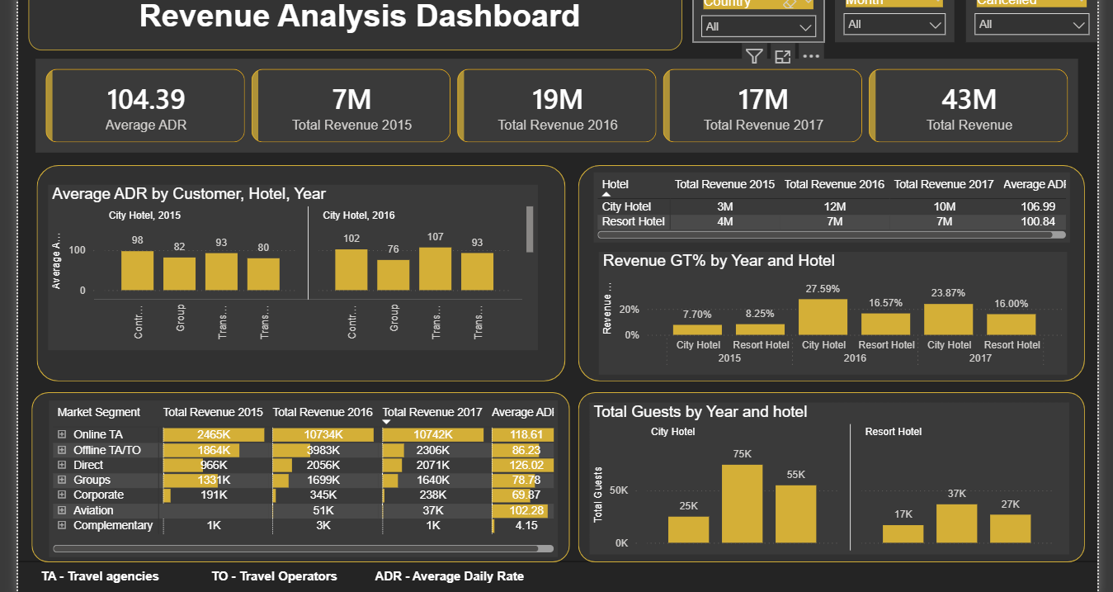
Executive Revenue Context
Focus: The Financial Big Picture.
What it shows:
Total revenue tracking ($26M monitored across 3 years).
ADR (Average Daily Rate) trends over time.
Revenue splits by Hotel Type (City vs. Resort).
The Takeaway:
Understands exactly where the money is coming from at a glance.

Slide 9
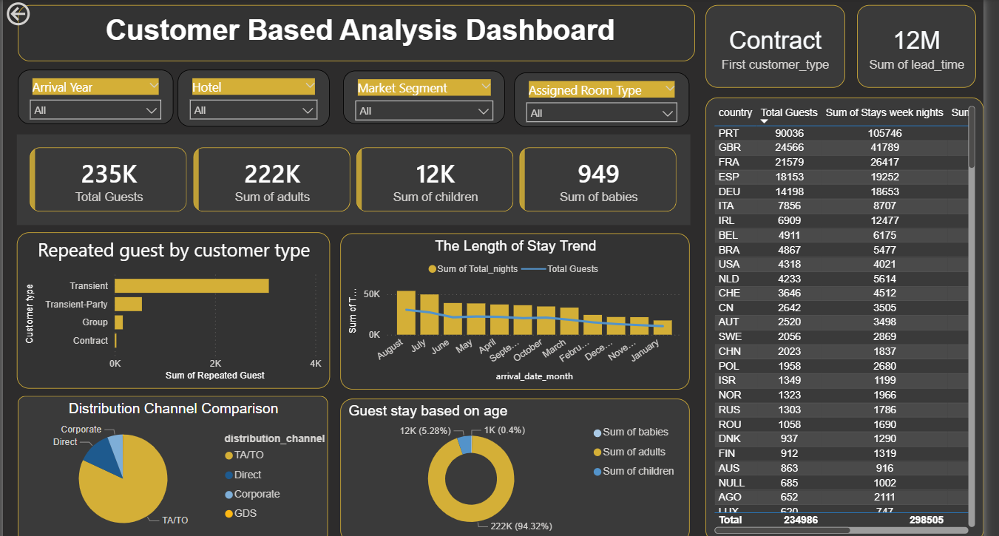
Customer Based Analysis
Focus: Knowing the Guest.
What it shows:
Market segment distribution (82.8% OTA vs. 11.2% Direct).
Guest composition (94.4% Adults vs. 5.1% Families).
Geographic hotspots (e.g., Portugal, France, Spain).
The Takeaway:
Identifies high-value geographic segments and dominant booking channels.

Slide 10
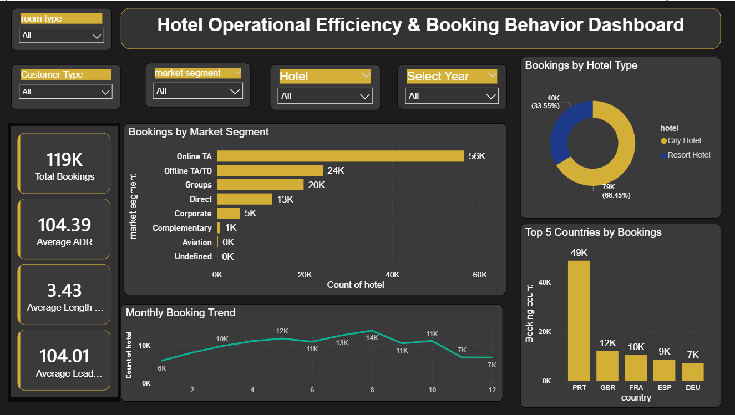
Operational Efficiency & Behavior
Focus: Day-to-Day Optimization.
What it shows:
Overall occupancy rates (averaging 62.6%).
Weekday vs. Weekend booking patterns.
Room type distribution and upgrade trends.
The Takeaway:
Helps operations teams align staffing and resources with peak booking windows.

Slide 11
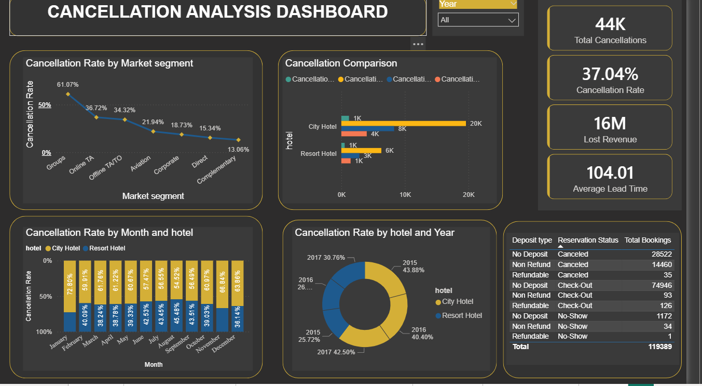
Cancellation Insights
Focus: Combating the Revenue Killer.
What it shows:
Cancellation rates isolated by segment (OTA vs. Direct).
Total revenue lost to cancellations.
How booking lead time impacts the likelihood of a guest canceling.
The Takeaway:
Pinpoints exactly when and why guests back out, allowing for better deposit policies.

Slide 12
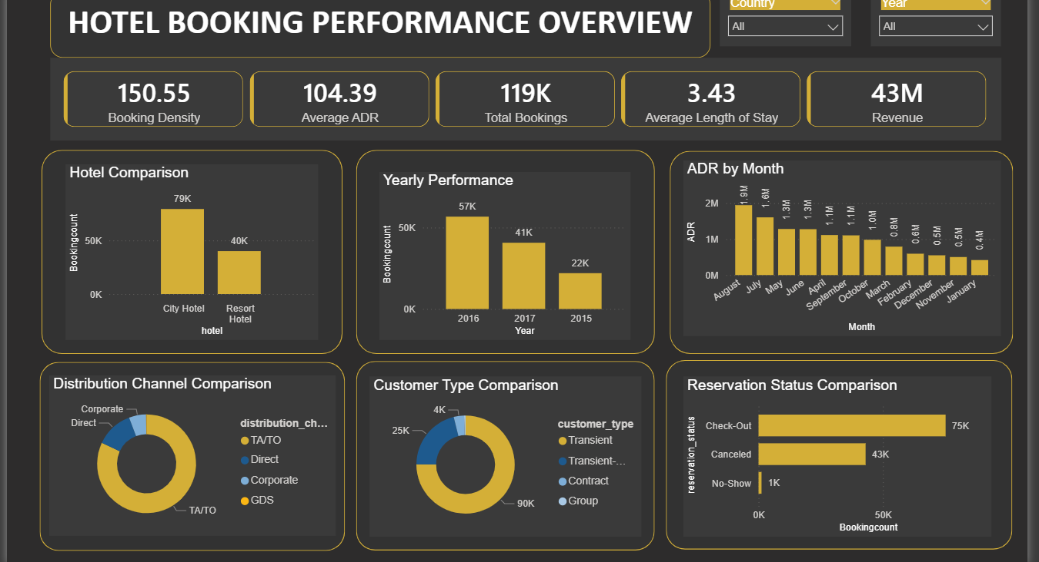
Overall Performance & Forecast
Focus: The Strategic Roadmap.
What it shows:
An executive KPI scorecard summarizing overall health.
Year-over-Year (YoY) growth comparisons.
Forward-looking performance trends.
The Takeaway:
Provides leadership with a clear summary to make informed decisions for the next fiscal quarter.

Slide 13
Professional Strategic Insights
Channel Mix Deficit: Over 82% of the booking volume is funneled through third-party OTAs. Transitioning even 10% of this traffic to direct booking channels would drastically elevate net yields by bypassing commission payouts.
The Lead Time Paradox: Predictive algorithms demonstrate that bookings secured with exceptionally long lead times carry an exponentially higher cancellation risk. Contractual enforcement of non-refundable deposits for long-horizon bookings is advised.

Slide 14
Professional Strategic Insights
Underpenetrated Demographics: Families with children/babies occupy only a fraction (under 6%) of total historical traffic. Targeted marketing to convert standard rooms into family-suite bundles is a major untapped revenue stream.
Dynamic Peak Optimization: Occupancy surges by over 40% during the Q3 summer window. Deploying automated premium-tier pricing during this window will maximize ADR without sacrificing occupancy.

Slide 15
Conclusion
Project Synthesis:
The HotelRev AI project successfully transitions fragmented,
raw booking data into a cohesive, interactive business intelligence ecosystem.
This empowers stakeholders with real-time visibility into financial
health and guest behavior.
Business Impact: By addressing cancellation vulnerabilities,
optimizing the distribution channel mix,
and leveraging seasonal demand insights, the organization is
positioned to significantly recover lost
revenue and enhance cross-departmental operational efficiency.

